Slide 1

MALLA REDDY INSTITUTE OF TECHNOLOGY AND SCIENCE
An UGC Autonomous Institution
Approved by AICTE New Delhi and Affiliated to JNTU
An ISO 9001: 2015 Certified Institution
Accredited by NBA and NAAC ‘A’ Grade
Maisammaguda, Medchal (Dist), Hyderabad -500100, Telangana.
Email : mrits.s1@gmail.com, www.mrits.ac.in
EAMCET Code: MRIT
JNTUH Code: S1
DEPARTMENT OF COMPUTER SCIENCE ENGINEERING
Auto Learn Nexus: A Task-Ontology Driven Framework for Fully Autonomous Machine Learning Model Generation
UNDER GUIDANCE OF:
Y.SWAPNA
ASSISTANT PROFESSOR
B.TECH(CSE),MBA
PRESENTED BY:
S.JHASMITHA ROJA-22S11A0519
T.NAVYA SRI-22S11A0532
RAJ AMAN KUMAR-22S11A0542
K.RAKSHITHA-22S11A0543

Slide 2
CONTEXT
Abstract
Existing system
Disadvantages
Proposed system
Advantages
Introduction
System Requirements
System Architecture
UML Diagrams
Software Environment
Results
Conclusion

Slide 3
ABSTRACT
Researchers are increasingly exploring artificial intelligence (AI) that recognizes, learns, infers, and acts on external information by integrating computing, big data, and machine learning (ML) algorithms. AI is widely applied across industries, and experts aim to standardize ML tools for easier use by non-experts. Research focuses on autonomous ML and ontology construction to standardize concepts. This paper classifies problem-solving steps for autonomous ML as tasks and presents a modeling method using task execution workflows. A task ontology-based model groups UML activities and applies transformation rules to automatically generate and extend ML models based on shared elements, relationships, and processes.

Slide 4
Existing system
The domain ontology can be defined as an 'explicit protocol for conceptualization’ of the problem. A task ontology is defined as 'extracting and organizing the concepts and relations existing in the problem solving process domain-independent'. In particular, a task ontology is a specification of the concept structure for the task execution process. Thus, the core concept is the subject of processing and the procedure of processing for a problem solving. In general, a person becomes a subject in a task ontology. However, in this paper, agents (programs) become subjects to perform the tasks.

Slide 5
Disadvantages
Early Stage of Development: Autonomous machine learning (AutoML) is still in its early stages, meaning its capabilities are evolving, and there is significant potential for improvement in automation and efficiency.
Task Optimization: Current AutoML techniques focus on minimizing unnecessary or repetitive tasks in the ML pipeline, reducing manual intervention and saving time for developers and researchers.
Progressive Refinement: These techniques refine workflows step by step, systematically improving model preparation processes such as feature engineering, hyperparameter tuning, and model selection.
Accuracy Improvement: By streamlining workflows and reducing manual effort, AutoML enhances the precision and performance of machine learning models, making them more reliable.

Slide 6
Proposed system
In the proposed system, we describe a typical problem solving process for the machine learning as tasks, present their procedure, and propose the modeling method of an autonomous machine learning for using task execution processes. The modeling method of autonomous machine learning based on the task ontology define a structure based grouping method of the UML(Unified Modeling Language) activities and implement a function to automatically generate models based on common elements and structures. The purpose of the proposed autonomous machine learning model is to model autonomous machine learning by reusing existing resources and producing new knowledge through relearning it.

Slide 7
Advantages
ML schema is a top-level ontology that provides classes, properties, and constraints for machine learning algorithms, datasets and experimentation suggested by the W3C(ML Schema community group).
It can be easily extended and refined, and can be mapped to other domain ontologies developed in the field of machine learning and data mining.

Slide 8
INTRODUCTION
While open-source ML frameworks lower entry barriers, fully autonomous ML is still evolving. AutoML aims to select optimal algorithms and hyper-parameters automatically.
Use a Task Ontology—an explicit, domain-independent structure of concepts and relations in a problem-solving process—to model the ML task execution.
Modeling Method:
  Abstraction: Core ML components (like Keras objectives, optimizers, etc.) are standardized and abstracted based on metadata using existing resources like ML Schema and the MEX vocabulary.
  Structure: This knowledge is organized into UML (Unified Modeling Language)-based Metamodels, where the core classes are Tasks and Processes.
  Automation: The model implements a function to automatically generate ML models by reusing existing resources and identifying common structures and elements.
To achieve consistency, reusability, and implementation-readiness in AutoML by formally specifying the knowledge base for task execution.

Slide 9
System requirements
HARDWARE REQUIREMENTS:
System : Pentium IV 2.4 GHz.
Hard Disk : 1 TB.
Floppy Drive : 1.44 Mb.
Monitor : 14’ Colour Monitor.
Mouse : Optical Mouse.
Ram : 4 GB.
SOFTWARE REQUIREMENTS:
Operating system : Windows 7 Ultimate.
Coding Language : Python.
Front-End : Python.
Designing : Html, css, javascript.
Data Base : MySQL.
FRAME WORK : DJANGO

Slide 10
SYSTEM ARCHITECTURE
The DFD is a simple graphical formalism that provides a clear representation of a system by focusing on the flow of information. Its primary functions are to:
Model Components: Show the essential parts of a system, including its processes, the data those processes use, external entities that interact with the system, and the information flows themselves.
Depict Transformation: Illustrate how information moves through a system, starting from its input and showing how it is modified by a series of transformations until the output data is generated.
A DFD can be used to represent a system at any level of abstraction. It can be partitioned into levels to represent increasing detail regarding both the information flow and the system's functional specifics.

Slide 11
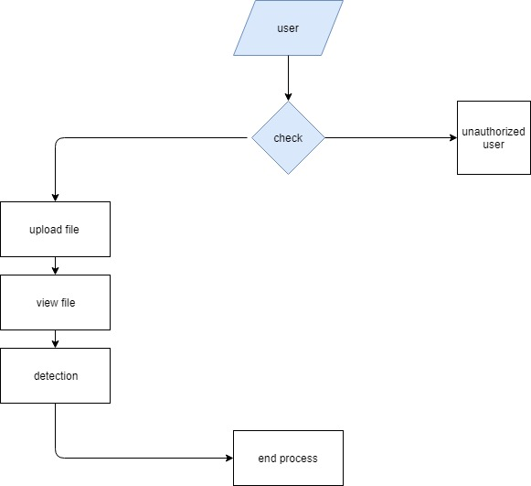
System architecture

Slide 12
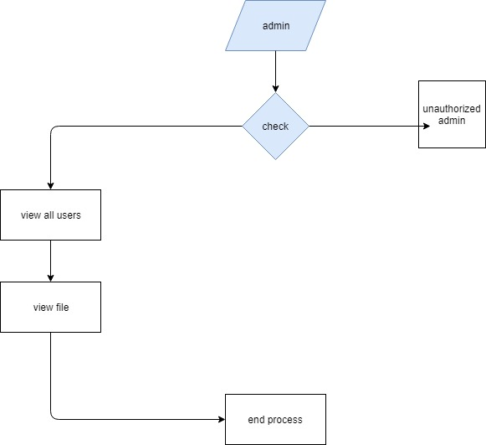
System architecture

Slide 13
Uml diagrams
UML stands for Unified Modeling Language. It is a standardized, general-purpose modeling language used primarily in object-oriented software engineering. The main goal of UML is to serve as a common language for modeling computer software. It provides a visual way to plan and describe a system before it is built, much like blueprints for a building.
UML represents a collection of best engineering practices proven successful in modeling large and complex systems. It is essential to the modern software development process.
In its current form, UML consists of two main parts:
A Meta-model (the rules and structure of the language).
A Notation (the graphical symbols used in the diagrams).
It uses mostly graphical notations to express the design of software projects. The standard is managed by the Object Management Group (OMG).

Slide 14
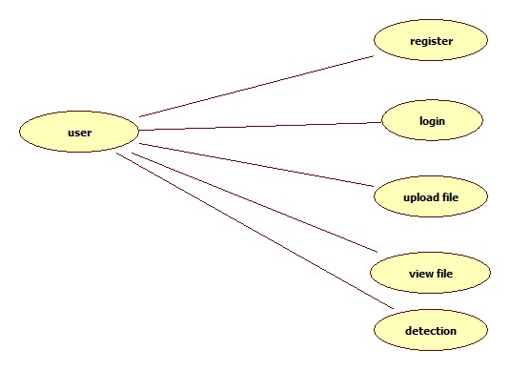
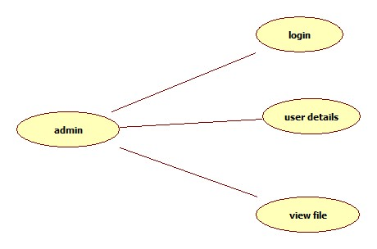
USE CASE DIAGRAM
A Use Case Diagram in the Unified Modeling Language (UML) is a behavioral diagram that provides a graphical overview of a system's functionality.
Its primary purpose is to show what system functions are performed for which actor.
Essentially, it quickly depicts the roles of the actors and the high-level functional requirements of the system.

Slide 15
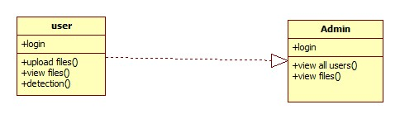
CLASS DIAGRAM
In software engineering, a class diagram in the Unified Modeling Language (UML) is a type of static structure diagram that describes the structure of a system by showing the system's classes, their attributes, operations (or methods), and the relationships among the classes. It explains which class contains information.

Slide 16
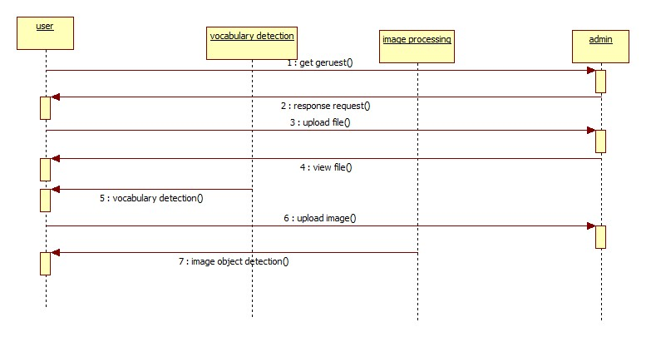
SEQUENCE DIAGRAM
A sequence diagram in Unified Modeling Language (UML) is a kind of interaction diagram that shows how processes operate with one another and in what order. It is a construct of a Message Sequence Chart. Sequence diagrams are sometimes called event diagrams, event scenarios, and timing diagrams.

Slide 17
SOFTWARE ENVIRONMENT
Python & Django in Auto Learn Nexus
Task-Ontology Driven Framework for Autonomous ML Model Generation
Python powers the core intelligence of the system — managing data processing, ontology mapping, model training, and performance optimization using ML libraries like scikit-learn, pandas, and TensorFlow.
It enables task-driven automation, where algorithms are selected dynamically based on dataset characteristics and ontology rules.
Django acts as the bridge between users and the ML engine, providing a secure and interactive web interface for dataset uploads, model execution, and result visualization.
Through its REST APIs and ORM, Django efficiently handles communication, database management, and real-time status tracking of ML tasks.
Together, Python and Django create a seamless, fully autonomous platform — integrating backend intelligence with a scalable, user-friendly web environment for end-to-end machine learning model generation.

Slide 18
SOFTWARE ENVIRONMENT
Role of Python in Auto Learn Nexus
Core ML Engine: Python serves as the backbone for implementing machine learning workflows—data pre processing, model selection, training, and evaluation.
Libraries Used: Utilized libraries like scikit-learn, pandas, NumPy, and TensorFlow/PyTorch for automation of model generation and performance analysis.
Ontology Integration: Python scripts manage the Task Ontology—mapping data characteristics to suitable algorithms automatically.
Automation Pipelines: Enables end-to-end automation for dataset ingestion, model tuning, and result logging.
Key Advantage: Simplifies experimentation, reduces manual coding, and supports dynamic ML model generation.

Slide 19
SOFTWARE ENVIRONMENT
Role of Django in Auto Learn Nexus
Web Interface: Django powers the interactive dashboard for users to upload datasets, monitor model training, and view results in real time.
Backend Logic: Handles communication between frontend and Python-based ML engine using Django views and REST APIs.
Database Management: Uses Django ORM to store task metadata, ontology mappings, and generated model performance metrics.
Security & Scalability: Provides built-in authentication, session handling, and modular structure for scaling ML services.
Outcome: Transforms the autonomous ML engine into a user-friendly web platform for model generation and deployment.

Slide 20
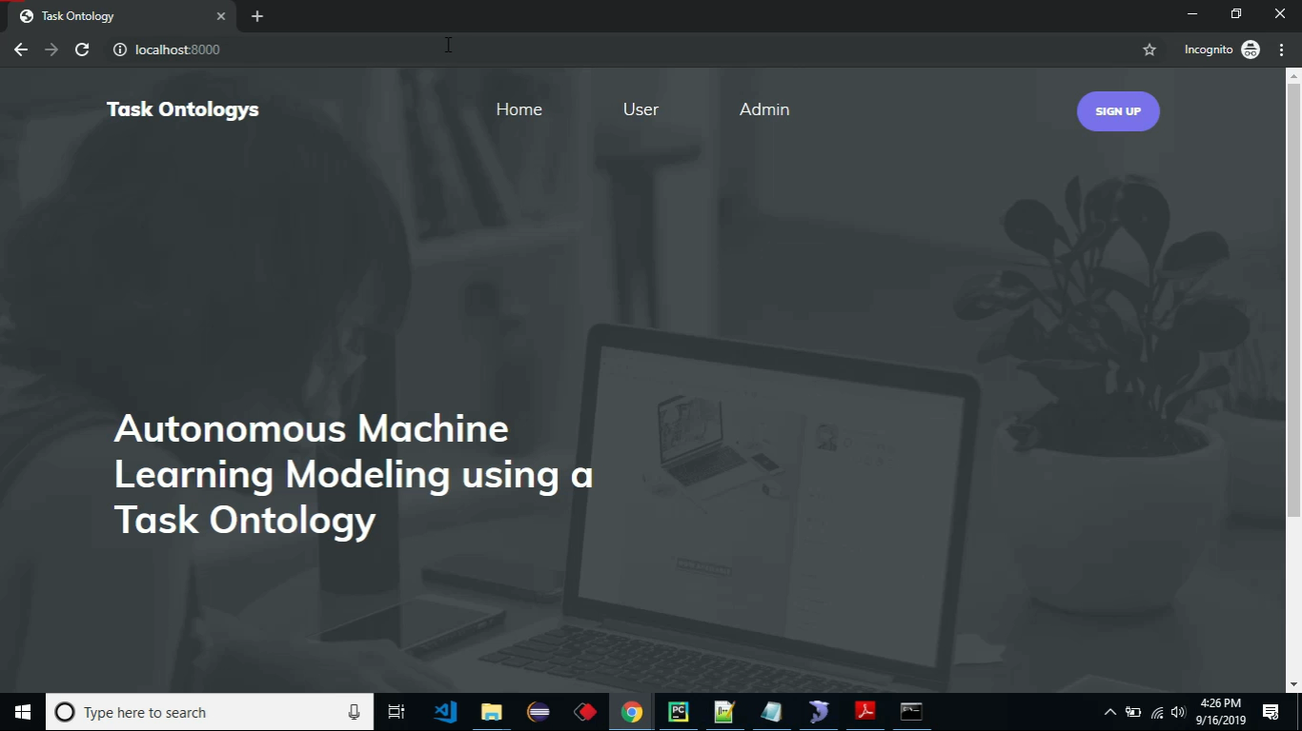
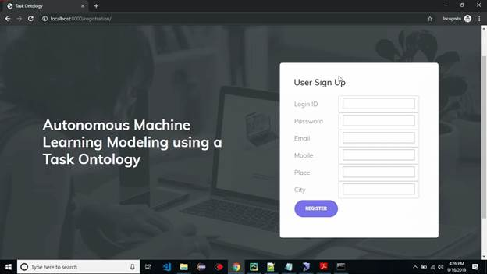
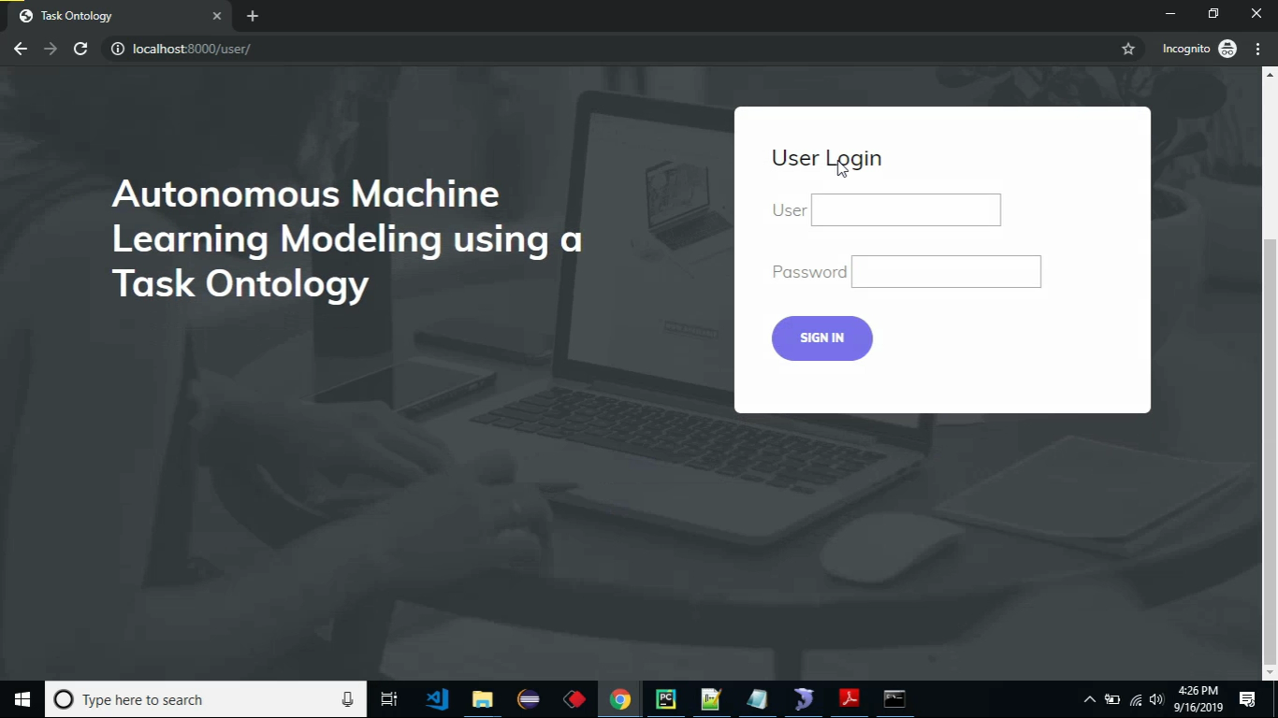
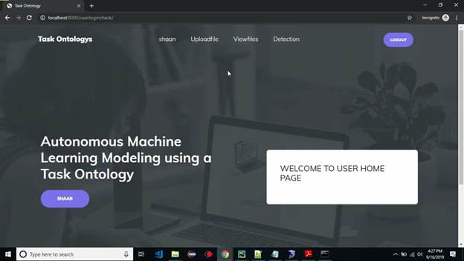
RESULTS

Slide 21
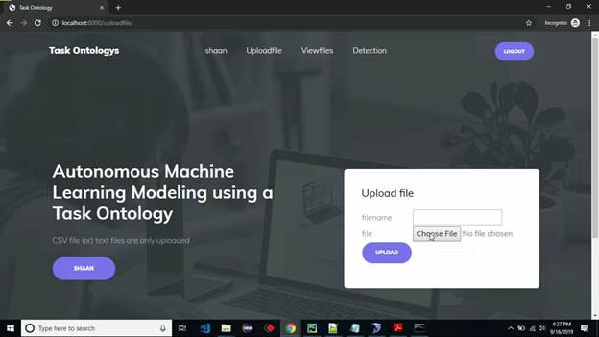
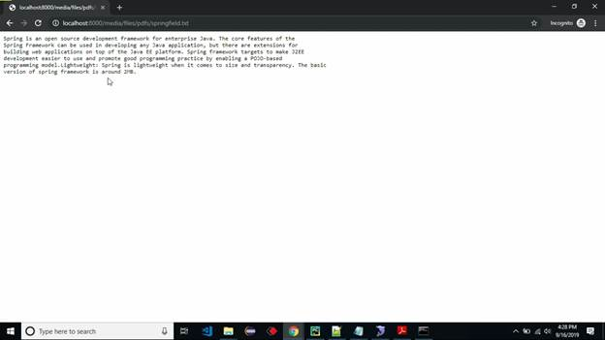
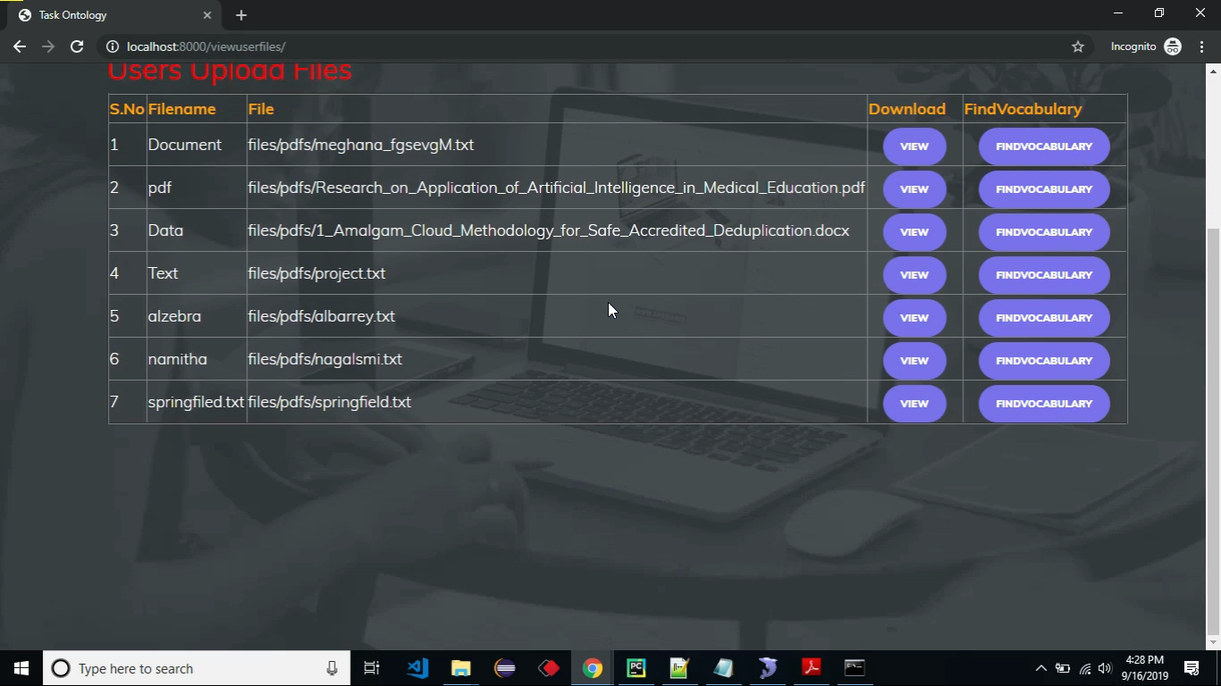
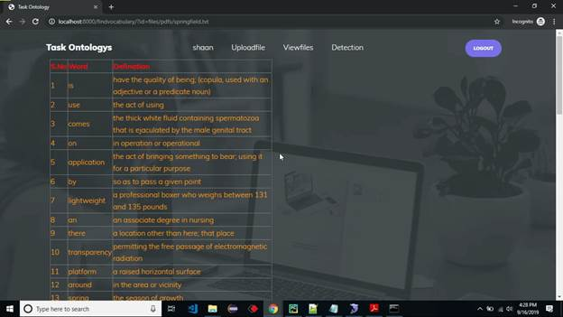
RESULTS

Slide 22
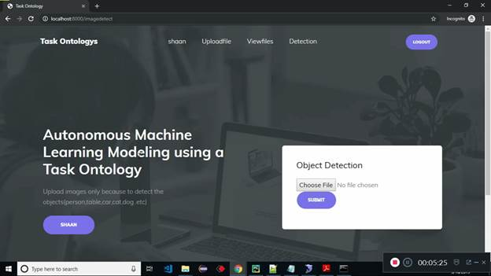
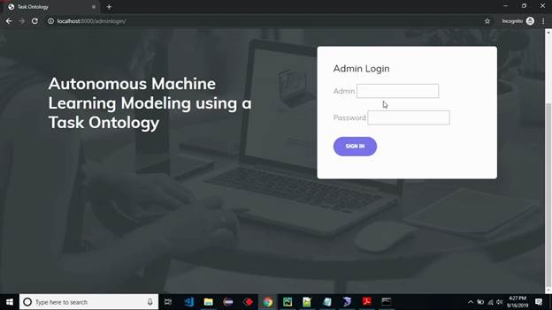
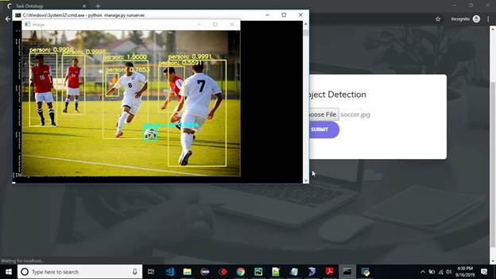
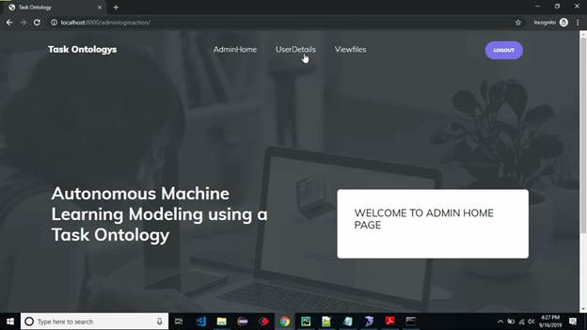
RESULTS

Slide 23
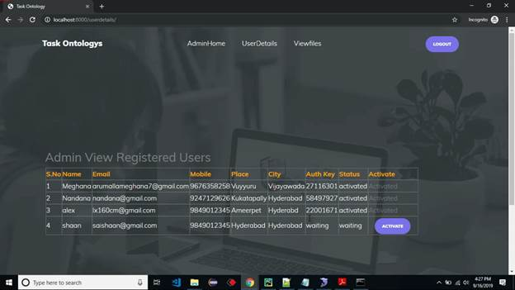
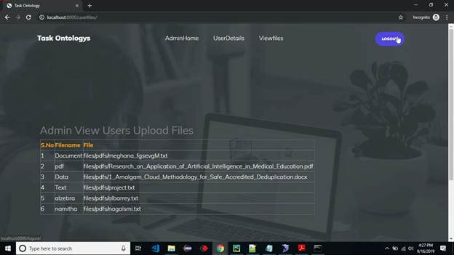
RESULTS

Slide 24
conclusion
In this presentation, we extracted important keywords for constructing an ontology from papers and textbooks about machine learning. Moreover we designed a task ontology based on the MEX vocabulary. We also studied workflow for the autonomous machine learning model. The proposed method is applicable for automatic workflow according to designated autonomous level. Therefore, the non-experts are capable of doing complex tasks using the proposed method and can easily implement the machine learning model in a specific application

Slide 25
Thank you

